Slide 1
ANJUMAN COLLEGE OF ENGINEERING & TECHNOLOGY
Department of Computer Science and Engineering
Subject-Database Management System
Prepared By
Prof. Qudsiya Naaz

Slide 2
SYLLABUS
Unit 1: General introduction to database systems, Database-DBMS distinction, Approaches to building a database, Data models, Three-schema architecture of a database, Challenges in building a DBMS, Various components of a DBMS, E/R Data model. SQL, PL/SQL Concept
Unit 2: Relational Data Model, Concept of relations, Schema-instance distinction, Keys, referential integrity and foreign keys, Relational algebra operators, Tuple relation calculus, Domain relational calculus.
Unit 3: Physical and logical hierarchy. Concept of index, B-trees, hash index, function index, bitmap index. Concepts of Functional dependency, Normalization, Business data analysis, tools & techniques for business data analysis.

Slide 3
SYLLABUS
Unit 4: Overview: Query Processing and Optimization, measures of query cost estimation in query optimization, pipelining and Materialization, Structure of query evaluation plans.
Unit 5: Transaction concepts, properties of transactions, serializability of transactions, testing for serializability, System recovery, Two- Phase Commit protocol, Recovery and Atomicity, Log based recovery, concurrent executions of transactions and related problems, Locking mechanism, solution to concurrency related problems, deadlock, , two-phase locking protocol, Isolation, Intent locking.
Unit 6: Recovery System: failure classification, recovery and atomicity, log based recovery, checkpoints, buffer management, advanced recovery techniques. Introduction to Web databases, distributed databases, data warehousing and data mining, Data Security.

Slide 4
COURSE OUTCOMES:
CO.1: identify the basic concepts and various data model used in database design ER modeling concepts and architecture use and design queries using SQL.
CO.2: apply relational database theory and be able to describe relational algebra expression, tuple and domain relation expression fro queries.
CO.3: recognize and identify the use of normalization and functional dependency, indexing and hashing technique used in database design.
CO.4: recognize/ identify the purpose of query processing and optimization and also demonstrate the basic of query evaluation.
CO.5: apply and relate the concept of transaction, concurrency control and recovery in database.
CO.6: discuss recovery system and be familiar with introduction to web database, distribute databases, data warehousing and mining.

Slide 5
FUNCTIONAL DEPENDENCY???

Slide 6
𝐴→𝐵
A function determines B and B is dependent on A.
A functional dependency is associated among two attribute of the same relational database table.
One of the attribute is called determinant and the other is called dependent.
For each value determinant there is associated with one value of dependent/determine.
Ex:
A is determinant and B is dependent, we can say that A functionally determines B or B is dependent on A. Graphically 𝐴→𝐵

Slide 7
CLASSIFICATIONOF F.D’s (normalization)
Trivial F.D: Function dependency $Y→X$ is trivial if and only if $Y⊆X AB→Y$
Non-trivial F.D: If there is at least one attribute in R.H.S that is not part of the L.H.S. $AB→BC$
Fully F.D: Given R and F.D. $X→Y$ , then Y is fully functional dependent on X if there is no Z, where Z is proper subset of X such that $X→Y$.
Partial Dependency: Given a relation R{2NF} with F.D F defined on attributes of R and K as a candidate key, if X is a proper subset of K and if $F ≠ X →A$, then A is said to be partially dependent on K.
Transitive Dependency: $X→Y, Y→A$, then A is transitively dependent on X.

Slide 8
AMSTRONG AXIOMS RULE / INFERENCE RULE
RULE 1: Reflexive rule
RULE 2: Augmentation rule
RULE 3: Transitive rule
Rule 4: Editive/union rule
RULE 5: Pseudo transitive rule
RULE 6: Productive/ Decomposition rule

Slide 9
RULE 1: Reflexive rule
If $X⊆Y$ then $Y→X$ and R is relational contains attributes R(A,B,C,D).
A functional determines A then:
$$A →A$$
$$ABC→ABC$$
$A→A$ and $ABC→ABC$ is reflexive because a set can determine its proper subset (every determinant attribute is subset of itself.
RULE 2: Argumentation rule
$X→Y$, X determine Y then XZ determines YZ $XZ→YZ$ or $Z→Z$ its reflexive $X→Y$ then add Z both the sides$XZ→YZ$argumentation rule $Z→Z$ reflexive rule
RULE 3: Transitive rule
If $X→Y$ and $Y→Z$ then using transitive rule $X→Z$

Slide 10
Rule 4: Editive/union rule
If $X→Y$and $X→Z$then using this rule, $X→YZ$
RULE 5: Pseudo transitive rule
If $X→Y$and $YZ→W$then using this rule, $XZ→W$
RULE 6: Productive/ Decomposition rule
If $X→YZ$then using this rule, $X→Y \text{and} X→W.$

Slide 11
CLOSURE SET OF ATTRIBUTE $(X^{+})$
Closure of attribute is the set of attribute which can be determined by that attribute. $X^{+}$ is the set of all the attributes that can be determined using the given set X.
$A→B$ and $B→C$
$A^{+}=\left\{ABC\right\} B^{+}=\{BC\}$

Slide 12
Application of attribute closure
Finding keys of a relation: If $X^{+}$ contains all attributes of a relation then X is called super key of R.
EX: $R\left(ABCDE\right)=\{A→BC, CD→E, B→D, E→A\}$ Find candidate keys of R.
Sol:
$$A^{+}=\left(ABCDE\right)$$
$${ (BC)}^{+}=\left(BCDEA\right)$$
$$({CD)}^{+}=\left(CDEABC\right)$$
$${ E}^{+}=EABCD$$
Candidate keys are: A, E, BC,CD.

Slide 13
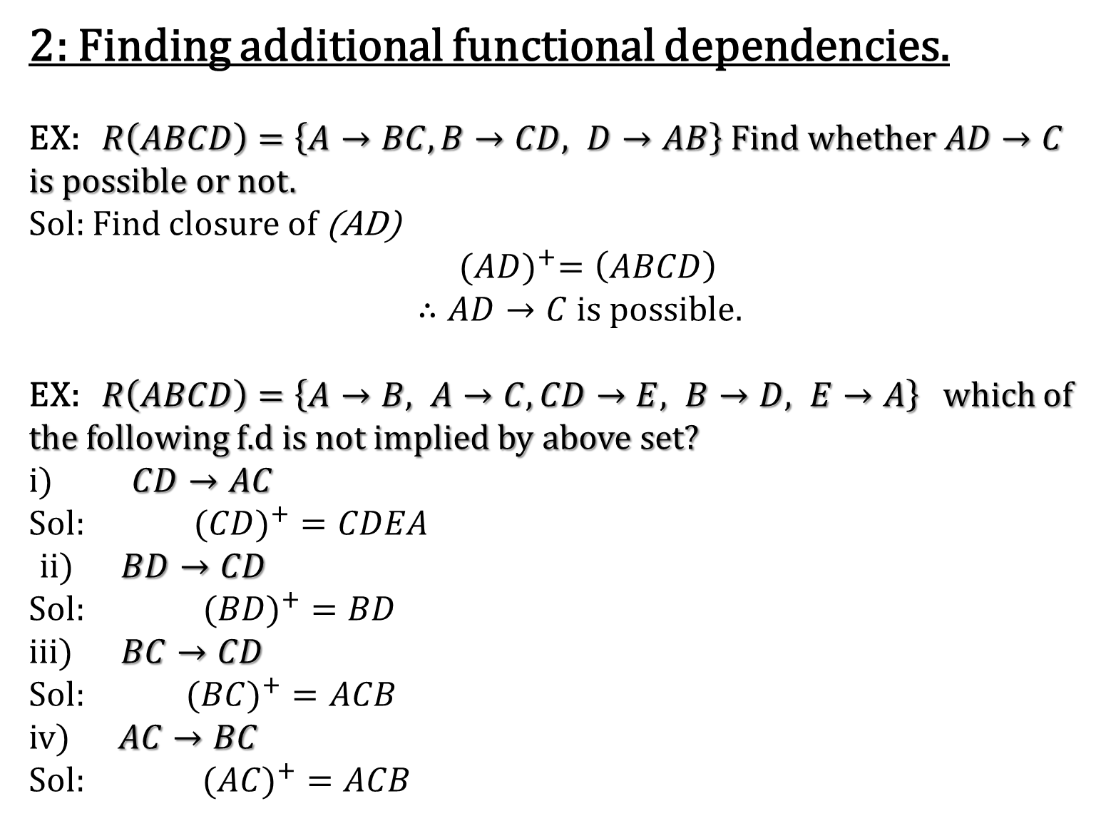
2: Finding additional functional dependencies.
EX: $R\left(ABCD\right)=\left\{A→BC, B→CD, D→AB\right\} Find whether AD→C$ is possible or not.
Sol: Find closure of (AD)
${(AD)}^{+}=\left(ABCD\right)$
$∴AD→C is possible.$
EX: $R\left(ABCD\right)=\left\{A→B, A→C, CD→E, B→D, E→A\right\}$which of the following f.d is not implied by above set?
i) $CD→AC$
Sol: $({CD)}^{+}=CDEA$
ii) $BD→CD$
Sol:$({BD)}^{+}=BD$
iii)$BC→CD$
Sol: $({BC)}^{+}=ACB$
iv)$AC→BC$
Sol: $({AC)}^{+}=ACB$

Slide 14
CANONICAL COVER(fc)/ MINIMUM COVER
A canonical cover fc of a set is a set of attribute. Fc is a minimal set of functional dependency equivalent to F such that it follows 2 rules:
No functional dependency in fc contains extraneous attribute.
Each left hand side of fd in fc is unique.
HOW TO FIND OUT CANONICAL COVER?
.
Singleton R.H.S attribute.
Removable of extraneous attribute clueless or extra attribute from the fd.
Removal of redundant f.d.

Slide 15
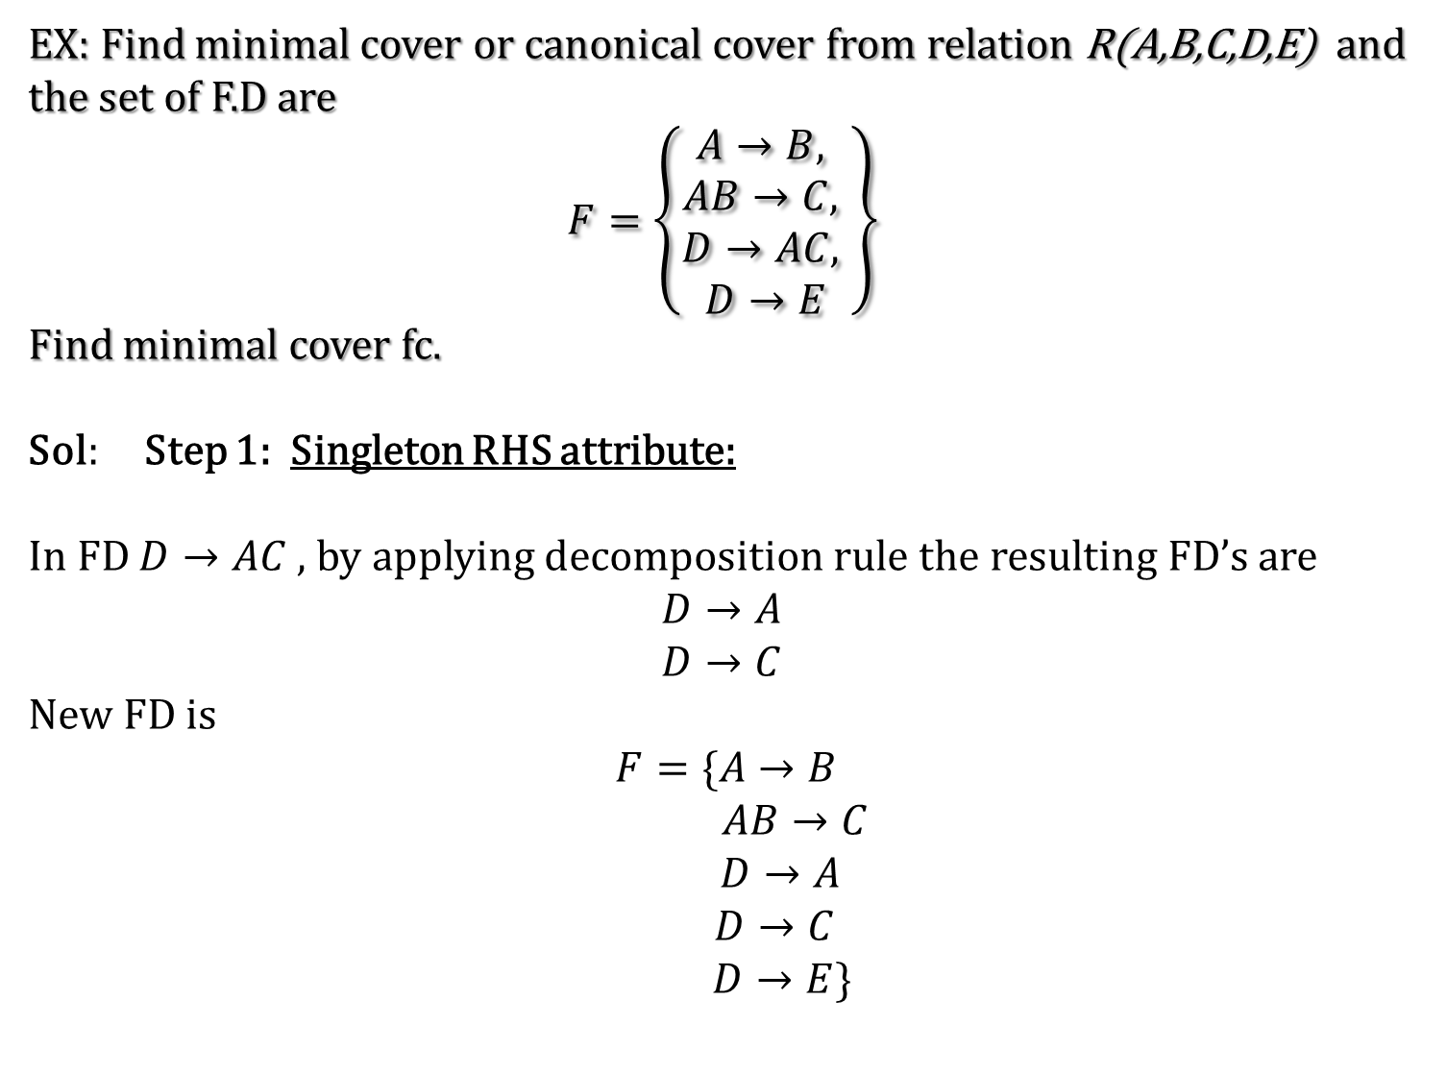
EX: Find minimal cover or canonical cover from relation R(A,B,C,D,E) and the set of F.D are
$F=\left\{\begin{aligned}A→B, \\ AB→C, \\ D→AC, \\ D→E\end{aligned}\right\}$
Find minimal cover fc.
Sol: Step 1: Singleton RHS attribute:
In FD $D→AC$, by applying decomposition rule the resulting FD’s are
$$D→A$$
$$D→C$$
New FD is
$F=\{A→B$
$AB→C$
$D→A$
$D→C$
$D→E\}$

Slide 16
Step 2: Remove Extraneous attribute:
If an attribute closure keeps only its own attribute by satisfying reflexivity that attribute in fd is extraneous attribute.
To find extraneous attribute, if an LHS has more than one attribute, check whether there exist an extraneous attribute. If so remove it.
In fd$AB→C$
$${(A)}^{+}=ABC$$
$B^{+}=B$(extraneous attribute)
So new set of fd are: $F=\{A→B$
$A→C$
$D→A$
$D→C$
$D→E\}$

Slide 17

Step 3: Removal of redundant FD
${(A)}^{+}=AC$
${(A)}^{+}=AB$
${(D)}^{+}=DCE$
${(D)}^{+}=DAEB$
${ (D)}^{+}=DC$AB
$D→C$ is redundant.
Therefore canonical cover is,
$F= \{A→B$
$A→C$
$D→A$
$D→E\}$

Slide 18
THANK YOU…

